Slide 1



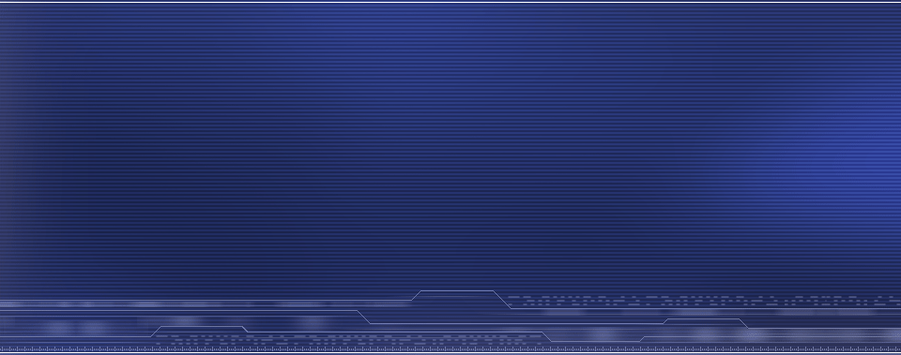

Your Global Technology Outsourcing Partner
EPAM POWER POINT TITLE
Software Testing Fundamentals
Introduction
Sub Topic
® 2011. EPAM Systems. All rights reserved.

Slide 2
Software Testing Fundamentals
Module 1: Introduction into Software Testing
Software Lifecycle Models and Testing

Slide 3
Software Lifecycle Models
Place of Testing in Software Lifecycle
Notes:
Студенты должны понять, что плохих моделей не бывает, бывает несоответственный выбор – не для того проекта, не для той команды, не для того заказчика

Slide 4
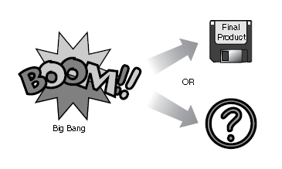
Big-Bang Model
Software Lifecycle Models: Big Bang Mogel
:
It’s simple
:
The result can be unpredictable
Notes:
Big-Bang Model
One theory of the creation of the universe is the big-bang theory. It states that billions of years ago, the universe was created in a single huge explosion of nearly infinite energy. Everything that exists is the result of energy and matter lining up to produce this book, floppy disks, and Bill Gates. If the atoms didn’t line up just right, these things might all be just quivering masses
of goop.
The big-bang model for software development shown in Figure follows much the same principle. A huge amount of matter (people and money) is put together, a lot of energy is expended—often violently—and out comes the perfect software product…or it doesn’t.
The beauty of the big-bang method is that it’s simple. There is little if any planning, scheduling, or formal development process. All the effort is spent developing the software and writing the code. It’s an ideal process if the product requirements aren’t well understood and the final release date is flexible. It’s also important to have very flexible customers, too, because they won’t know what they’re getting until the very end.
Notice that testing isn’t shown in Figure. In most cases, there is little to no formal testing done under the big-bang model. If testing does occur, it’s squeezed in just before the product is released. It’s a mystery why testing is sometimes inserted into this model, but it’s probably to make everyone feel good that some testing was performed.
If you are called in to test a product under the big-bang model, you have both an easy and a difficult task. Because the software is already complete, you have the perfect specification—the product itself. And, because it’s impossible to go back and fix things that are broken, your
job is really just to report what you find so the customers can be told about the problems.
The downside is that, in the eyes of project management, the product is ready to go, so your work is holding up delivery to the customer. The longer you take to do your job and the more bugs you find, the more contentious the situation will become. Try to stay away from testing in this model.

Slide 5
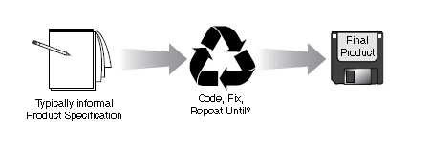
Code-and-Fix Model
No administrative overhead
Signs of progress (code) early
Low expertise, anyone can use it!
Useful for small “proof of concept” projects, e.g. as part of risk reduction
:
Dangerous!
No visibility/control
No resource planning
No deadlines
Mistakes hard to detect/correct
Impossible for large projects, communication breakdown, chaos
:
Notes:
The code-and-fix model shown in Figure is usually the one that project teams fall into by default if they don’t consciously attempt to use something else. It’s a step up, procedurally, from the big-bang model, in that it at least requires some idea of what the product requirements are.
A wise man once said, “There’s never time to do it right, but there’s always time to do it over.”
That pretty much sums up this model. A team using this approach usually starts with a rough idea of what they want, does some simple design, and then proceeds into a long repeating cycle of coding, testing, and fixing bugs. At some point they decide that enough is enough and release the product.
As there’s very little overhead for planning and documenting, a project team can show results immediately. For this reason, the code-and-fix model works very well for small projects intended to be created quickly and then thrown out shortly after they’re done, such as prototypes
and demos. Even so, code-and-fix has been used on many large and well-known software products. If your word processor or spreadsheet software has lots of little bugs or it just doesn’t seem quite finished, it was likely created with the code-and-fix model.
Like the big-bang model, testing isn’t specifically called out in the code-and-fix model but does play a significant role between the coding and the fixing.
As a tester on a code-and-fix project, you need to be aware that you, along with the programmers, will be in a constant state of cycling. As often as every day you’ll be given new or updated releases of the software and will set off to test it. You’ll run your tests, report the bugs,
and then get a new software release. You may not have finished testing the previous release when the new one arrives, and the new one may have new or changed features. Eventually, you’ll get a chance to test most of the features, find fewer and fewer bugs, and then someone (or the schedule) will decide that it’s time to release the product.
You will most likely encounter the code-and-fix model during your work as a software tester. It’s a good introduction to software development and will help you appreciate the more formal methods.

Slide 6
Waterfall Lifecycle Model
Software Lifecycle Models: Sequential Models
Waterfall Lifecycle Model - each phase must be completed in its entirety before the next phase can begin.
Simple and easy to use
Easy to manage due to the rigidity of the model – each phase has specific deliverables and a review process
Phases are processed and completed one at a time
Works well for smaller projects where requirements are very well understood
:
Requirements Analysis
Architectural Design
Detailed
Design
Code
:
Testing
Adjusting scope during the life cycle can kill a project
No working software is produced until late during the life cycle
High amounts of risk and uncertainty
Poor model for complex and object-oriented projects
Poor model for long and ongoing projects
Poor model where requirements are at a moderate to high risk of changing
Maintenance and Support
Remove from Service
Notes:
This is the most common and classic of life cycle models, also referred to as a linear-sequential life cycle model. It is very simple to understand and use. In a waterfall model, each phase must be completed in its entirety before the next phase can begin. At the end of each phase, a review takes place to determine if the project is on the right path and whether or not to continue or discard the project.
Requirement (Diagram)
a. Design
b. Implementation &amp; Unit Testing
c. Integration &amp; System Testing
d. Operation
Advantages
a. Simple and easy to use.
b. Easy to manage due to the rigidity of the model – each phase has specific deliverables and a review process.
c. Phases are processed and completed one at a time.
d. Works well for smaller projects where requirements are very well understood.
Disadvantages
a. Adjusting scope during the life cycle can kill a project
b. Poor model for complex and object-oriented projects.
c. Poor model for long and ongoing projects.
d. Poor model where requirements are at a moderate to high risk of changing.

Slide 7
V Lifecycle Model
Software Lifecycle Models: Sequential Models
Requirements Analysis
Acceptance Test
Architectural Design
System
Test
:
:
Very inflexible,
like the waterfall mode.
Little flexibility and adjusting
scope is difficult and expensive
Software is developed during
the implementation phase, so
no early prototypes of
the software are produced
Model doesn't provide a clear
path for problems found
during testing phases
Simple and easy to use
Each phase has specific deliverables
Higher chance of success over the waterfall model due to the development of test plans early on during the life cycle
Works well for where requirements are easily understood
Detailed
Design
Integration
Test
Code and Unit Testing
Notes:
Just like the waterfall model, the V-Shaped life cycle is a sequential path of execution of processes. Each phase must be completed before the next phase begins. Testing is emphasized in this model more so than the waterfall model though. The testing procedures are developed early in the life cycle before any coding is done, during each of the phases preceding implementation.
Requirements begin the life cycle model just like the waterfall model. Before development is started, a system test plan is created. The test plan focuses on meeting the functionality specified in the requirements gathering.
The high-level design phase focuses on system architecture and design. An integration test plan is created in this phase as well in order to test the pieces of the software systems ability to work together.
The low-level design phase is where the actual software components are designed, and unit tests are created in this phase as well.
The implementation phase is, again, where all coding takes place. Once coding is complete, the path of execution continues up the right side of the V where the test plans developed earlier are now put to use.
Advantages
a. Simple and easy to use.
b. Each phase has specific deliverables.
c. Higher chance of success over the waterfall model due to the development of test plans early on during the life cycle.
d. Works well for small projects where requirements are easily understood.
Disadvantages
a. Very rigid, like the waterfall model.
b. Software is developed during the implementation phase, so no early prototypes of the software are produced.
c. Model doesn’t provide a clear path for problems found during testing phases.

Slide 8
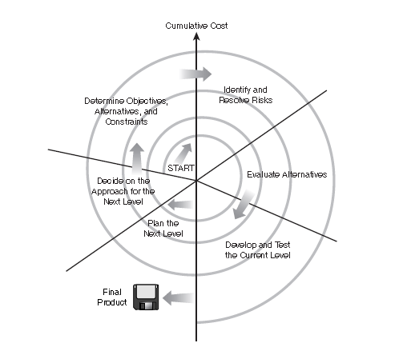
Spiral Model
:
Realism: the model accurately reflects the iterative nature of software development on projects with unclear requirements
Flexible: incorporates the advantages of the waterfall and rapid prototyping methods
Comprehensive model decreases risk
Good project visibility
:
Matching to contract software
Relying on risk management expertise
Need for further elaboration of spiral steps
Notes:
It’s not quite utopia, but the spiral goes a long way in addressing many of the problems inherent with the other models while adding a few of its own nice touches.
The spiral model was introduced by Barry Boehm in 1986 in his Association for Computing Machinery (ACM) paper, “A Spiral Model of Software Development and Enhancement.” It’s used fairly often and has proven to be an effective approach to developing software.
The general idea behind the spiral model is that you don’t define everything in detail at the very beginning. You start small, define your important features, try them out, get feedback from your customers, and then move on to the next level. You repeat this until you have your final product.
Each time around the spiral involves six steps:
1. Determine objectives, alternatives, and constraints.
2. Identify and resolve risks.
3. Evaluate alternatives.
4. Develop and test the current level.
5. Plan the next level.
6. Decide on the approach for the next level.
Built into the spiral model is a bit of waterfall (the steps of analysis, design, develop, test), a bit of code-and-fix (each time around the spiral), and a bit of big-bang (look at it from the outside).
Couple this with the lower costs of finding problems early, and you have a pretty good development model.
If you’re a tester, you’ll like this model. You’ll get a chance to influence the product early by being involved in the preliminary design phases. You’ll see where the project has come from and where it’s going. And, at the very end of the project, you won’t feel as rushed to perform all your testing at the last minute. You’ve been testing all along, so the last push should only be a validation that everything is OK.

Slide 9
Iterative Lifecycle Model
Software Lifecycle Models: Iterative Model
Start
:
Requirements Analysis
Architectural and Detailed Design
High amount of requirements analysis
Good for large and mission-critical projects
Software is produced early in the software life cycle
Review
Implementation & Testing
:
Complete
Can be a costly model to use
Doesn’t work well for smaller projects
Notes:
Итеративная модель предполагает совершенствование продукта через итерации. В каждой итерации коллектив разработчиков выполняет сборку программы. Каждая сборка является потенциальным кандидатом для тестирования. Для каждой сборки могут разрабатываться или уточняться тесты. Поскольку процесс разработки является итерационным некоторые тесты, используемые при тестировании ранних сборок, могут быть использованы и при тестировании последующих сборок. Такой процесс тестирования называется регрессионным тестированием, как вы уже знаете. Каждая новая итерации подразумевает повторное тестирование всех компонентов, разработанных на предыдущей итерации, плюс разработка тестов для тестирования новых компонент и их тестирование. Хотя, это может быть и не так. Все зависит от выбранной стратегии. Например, на начальном этапе разработки продукта может быть выбрана стратегия тестирования только новой функциональности, сделанной в данном конкретном билде. Конечно же при таком подходе есть риски, что сломается что-то из того, что уже было сделано в предыдущих билдах, и в какой-то момент, эти проблемы не будут найдены. Но, как правило, в проекте всегда есть фаза баг-фиксинга, в течение которой разработчики усиленно работают над устранением ошибок (как правило, вся функциональность к этому времени уже сделана), а тестировщики проводят регрессионные тесты, которые позволят выявить все эти проблемы, пропущенные на этапе тестирования новой функциональности.
В EPAM принята итеративная схема разработки программных продуктов

Slide 10
Agile Development
Scrum
Notes:
Agile means being able to quickly change direction. Agile software development is a group of software development methodologies. Agile software development methods: 1. Agile Modeling 2. Agile Unified Process (AUP) 3. Dynamic Systems Development Method (DSDM) 4. Essential Unified Process (EssUP) 5. Extreme Programming (XP) 6. Feature Driven Development (FDD) 7. Open Unified Process (OpenUP) 8. Scrum 9. Velocity tracking

Slide 11
Agile Principles
Customer satisfaction by rapid, continuous delivery of useful software
Even late changes in requirements are welcome
Working software is delivered frequently (weeks rather than months)
The developers are working closely and daily with the people who know the business
Projects supported by motivated and reliable people
A conversation in person is the best way of communication, which means that people are quite the same place
Working software is the first measure of progress
The development can always be continued
There is constant attention to technical excellence and good design
Simplicity is key: more is not done, the better
The teams organize themselves
It adapts to the circumstances

Slide 12
Scrum
Iterative, incremental framework for project management often seen in agile software development, a type of software engineering
Multidisciplinary teams
In short sprints (iterations) deliver working software.
Cooperation, communication and team spirit are the key words
Notes:
Scrum is an iterative, incremental framework for project management often seen in agile software development, a type of software engineering.
Although the Scrum approach was originally suggested for managing product development projects, its use has focused on the management of software development projects, and it can be used to run software maintenance teams or as a general project/program management approach.
History
In 1986, Hirotaka Takeuchi and Ikujiro Nonaka described a new approach to commercial product development that would increase speed and flexibility, based on case studies from manufacturing firms in the automotive, computer, photocopier, and printer industries. They called this the holistic or rugby approach, as the whole process is performed by one cross-functional team across multiple overlapping phases, where the team "tries to go the distance as a unit, passing the ball back and forth".
In 1991, DeGrace and Stahl first referred to this as the scrum approach. In rugby, a scrum refers to the manner of restarting the game after a minor infraction. In the early 1990s, Ken Schwaber used such an approach at his company, Advanced Development Methods, and Jeff Sutherland, with John Scumniotales and Jeff McKenna, developed a similar approach at Easel Corporation, and were the first to refer to it using the single word Scrum.
In 1995, Sutherland and Schwaber jointly presented a paper describing the Scrum methodology at the Business Object Design and Implementation Workshop held as part of OOPSLA ’95 in Austin, Texas, its first public presentation. Schwaber and Sutherland collaborated during the following years to merge the above writings, their experiences, and industry best practices into what is now known as Scrum.
In 2001, Schwaber teamed up with Mike Beedle to describe the method in the book Agile Software Development with Scrum.
Although the word is not an acronym, some companies implementing the process have been known to spell it with capital letters as SCRUM. This may be due to one of Ken Schwaber’s early papers, which capitalized SCRUM in the title.
Main Principles
Scrum is a process skeleton that contains sets of practices and predefined roles.
The main roles in Scrum are:
the “ScrumMaster”, who maintains the processes (typically in lieu of a project manager)
the “Product Owner”, who represents the stakeholders and the business
the “Team”, a cross-functional group who do the actual analysis, design, implementation, testing, etc.
During each “sprint”, typically a two to four week period (with the length being decided by the team), the team creates a potentially deliverable product increment (for example, working and tested software). The set of features that go into a sprint come from the product “backlog”, which is a prioritized set of high level requirements of work to be done. Which backlog items go into the sprint is determined during the sprint planning meeting. During this meeting, the Product Owner informs the team of the items in the product backlog that he or she wants completed. The team then determines how much of this they can commit to complete during the next sprint, and records this in the sprint backlog. During a sprint, no one is allowed to change the sprint backlog, which means that the requirements are frozen for that sprint. Development is timeboxed such that the sprint must end on time; if requirements are not completed for any reason they are left out and returned to the product backlog. After a sprint is completed, the team demonstrates how to use the software.
Scrum enables the creation of self-organizing teams by encouraging co-location of all team members, and verbal communication between all team members and disciplines in the project.
A key principle of Scrum is its recognition that during a project the customers can change their minds about what they want and need (often called requirements churn), and that unpredicted challenges cannot be easily addressed in a traditional predictive or planned manner. As such, Scrum adopts an empirical approach—accepting that the problem cannot be fully understood or defined, focusing instead on maximizing the team’s ability to deliver quickly and respond to emerging requirements.
Like other agile development methodologies, Scrum can be implemented through a wide range of tools. Many companies use universal software tools, such as spreadsheets to build and maintain artifacts such as the sprint backlog. There are also open-source and proprietary software packages dedicated to management of products under the Scrum process. Other organizations implement Scrum without the use of any software tools, and maintain their artifacts in hard-copy forms such as paper, whiteboards, and sticky notes

Slide 13
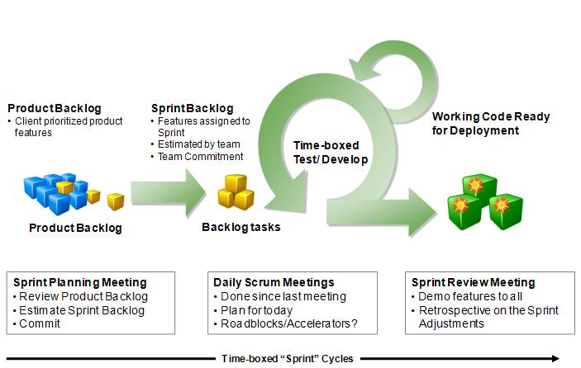
Scrum Process and Artifacts
Notes:
The Product Backlog is the master list of all functionality desired in the product. A product or a project backlog is a prioritized list of requirements with a rough size and complexity estimate of each requirement. Hence, the backlog has 3 components: requirements, priority, rough size and complexity estimate. Sprint Backlog: The sprint backlog is the list of tasks that the Scrum team is committing that they will complete in the current sprint. Items on the sprint backlog are drawn from the Product Backlog, by the team based on the priorities set by the Product Owner. Daily SCRUM meeting rules: 1. Hold the daily scrum in the same place at the same time every work day. 2. All team members are required to attend. 3. The scrum master begins the meeting by starting with the person to his or her left and proceeding counter clockwise around the room until everyone has reported. 4. Each team member should respond to three questions only: a) What have you done since the last daily scrum regarding this project? b) What will you do between now and the next daily scrum meeting regarding this project?
Scrum of Scrums
Each day normally after the daily scrum.
These meetings allow clusters of teams to discuss their work, focusing especially on areas of overlap and integration.
A designated person from each team attends.
The agenda will be the same as the Daily Scrum, plus the following four questions:
What has your team done since we last met?
What will your team do before we meet again?
Is anything slowing your team down or getting in their way?
Are you about to put something in another team’s way?
Sprint Planning Meeting
At the beginning of the sprint cycle (every 7–30 days), a “Sprint Planning Meeting” is held.
Select what work is to be done
Prepare the Sprint Backlog that details the time it will take to do that work, with the entire team
Identify and communicate how much of the work is likely to be done during the current sprint
Eight hour time limit
(1st four hours) Product Owner + Team: dialog for prioritizing the Product Backlog
(2nd four hours) Team only: hashing out a plan for the Sprint, resulting in the Sprint Backlog
At the end of a sprint cycle, two meetings are held: the “Sprint Review Meeting” and the “Sprint Retrospective”
Sprint Review Meeting
Review the work that was completed and not completed
Present the completed work to the stakeholders (a.k.a. “the demo”)
Incomplete work cannot be demonstrated
Four hour time limit
Sprint Retrospective
All team members reflect on the past sprint
Make continuous process improvements
Two main questions are asked in the sprint retrospective: What went well during the sprint? What could be improved in the next sprint?
Three hour time limit
----------------------------
Artifacts
Product Backlog
The product backlog is a high-level list that is maintained throughout the entire project. It aggregates backlog items: broad descriptions of all potential features, prioritized as an absolute ordering by business value. It is therefore the “What” that will be built, sorted by importance. It is open and editable by anyone and contains rough estimates of both business value and development effort. Those estimates help the Product Owner to gauge the timeline and, to a limited extent prioritize. For example, if the “add spellcheck” and “add table support” features have the same business value, the one with the smallest development effort will probably have higher priority, because the ROI (Return on Investment) is higher.
The Product Backlog, and business value of each listed item is the property of the product owner. The associated development effort is however set by the Team.
Sprint Backlog
The sprint backlog is the list of work the team must address during the next sprint. Features are broken down into tasks, which, as a best practice, should normally be between four and sixteen hours of work. With this level of detail the whole team understands exactly what to do, and potentially, anyone can pick a task from the list. Tasks on the sprint backlog are never assigned; rather, tasks are signed up for by the team members as needed, according to the set priority and the team member skills. This promotes self-organization of the team, and developer buy-in.
The sprint backlog is the property of the team, and all included estimates are provided by the Team. Often an accompanying task board is used to see and change the state of the tasks of the current sprint, like “to do”, “in progress” and “done”.
Burn down
The sprint burn down chart is a publicly displayed chart showing remaining work in the sprint backlog. Updated every day, it gives a simple view of the sprint progress. It also provides quick visualizations for reference. There are also other types of burndown, for example the release burndown chart that shows the amount of work left to complete the target commitment for a Product Release (normally spanning through multiple iterations) and the alternative release burndown chart which basically does the same, but clearly shows scope changes to Release Content, by resetting the baseline. It should not be confused with an earned value chart.

Slide 14
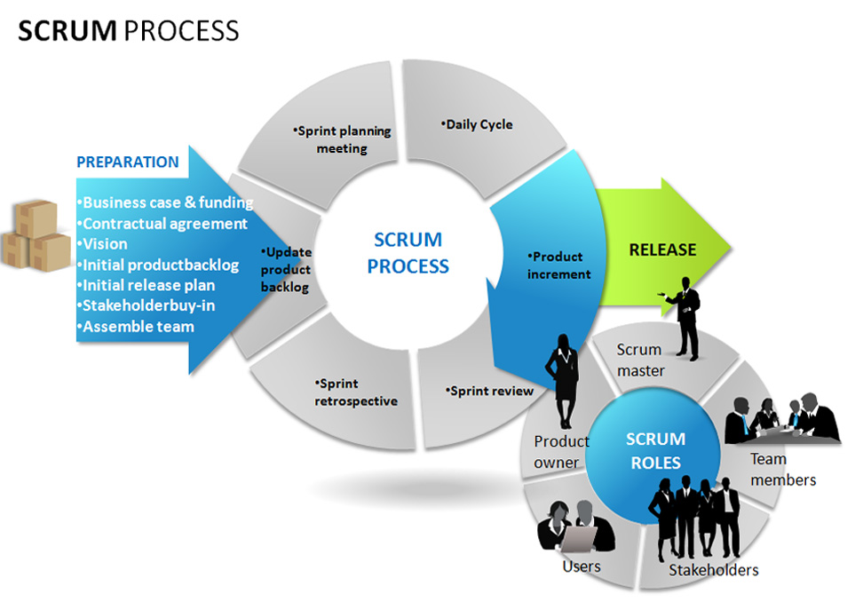
Scrum Process and Roles
Notes:
Scrum is an iterative incremental process of software development commonly used with agile software development. Software developed during one unit of time is referred to as an iteration, which typically lasts from two to four weeks. Each iteration passes through a full software development cycle, including planning, requirements analysis, design, writing unit tests, then coding until the unit tests pass and a working product is finally demonstrated to stakeholders.
Roles
Product Owner (PO) The PO is a single person who represents the customer/organization's interest in seeing the product's completion. The PO stands as the authority of all matters regarding the final product. They are responsible for deciding what features are required and prioritizing said features based on organizational interests. Unlike a traditional "sponsor" who may just fulfill the purpose of sign-offs, the product owner is seen as an essential part of the project's team and is always available to the others. Although they have an active part within the project, steering the direction of the product, communicating with stakeholders, and helping resolve certain impediments (organizational, especially), the PO is not a management figure (although they should ideally possess good management qualities, such being decisive; having a vision, good communication, etc.). This is counter to how an effective Scrum Team should operate, and the PO should not put or find themselves in such a position. ScrumMaster The ScrumMaster is also not a manager; he is instead their best friend. The ScrumMaster's role is to create and maintain an environment that allows the Scrum Team to communicate, work efficiently, drive themselves, and continually improve. They are also responsible for keeping and displaying information that shows the progress of the project, as well as aiding the Product Owner so that the PO can properly utilize Scrum with correct prioritizing of features and integration as a part of the team. It is also the ScrumMaster's role is to protect and insulate the team from external sources (and the PO, if necessary) during the Sprint cycle, and ensure that their commitment doesn't break. "The ScrumMaster's job is to project the process" - Jens Ostergaard
Scrum Team The Scrum Team is everyone who will be performing the actual work (i.e., construction and development of the product) during the Sprint cycles. This is a small group of seven (give or take two) that should consist of cross-functional individuals who can fulfill multiple roles in development. Key to the Scrum Team is that they are self-organizing and motivated, as they are expected to be able to work without management and take personal responsibility for much of the development that happens. While it is not always possible, it is suggested that Scrum Teams co-locate to the same area to improve communication and team dynamics, which should result in a higher velocity.

Slide 15
Benefits
Much contact and communication can provide a high team spirit. The project is seen as a whole instead of considering various aspects like islands
Because much happening at once, the duration of a project are shorter than other methods
Because problems are known to everyone, this site earlier reactions
Notes:
Strengths It fosters buy-in among the development team as they are have a greater sense of responsibility and influence to the end product.
It fosters buy-in among stakeholders (including the PO) as their continued feedback and feature requests are an integral part of the project.
It encourages customer confidence as stakeholders are given frequent demos of a working product that has its most important features integrated early on in development.
It is lightweight, its concepts easy to pick up, and there are very few roles and artifacts to track.
It does not require sophisticated tools (you could get away with just using spreadsheet software to track velocity and generate the Burndown Chart, and even that could be done manually).
It keeps teams motivated with continual "small wins" in the form of Sprint Tasks, Sprint Goals and iterations of the product.
It is able to adapt to changing requirements.
It promotes open communication among the development team and stakeholders.
Its lack of developmental processes means that it can be adapted to suit a wide variety of projects, not just software systems.
Its uncertainty is known up front, and each sprint cycle reduces uncertainty (as opposed to traditional development which can be "almost like a surprise party" by the end of a project).
It is considered a "Silver Mirror" (as opposed to a Silver Bullet) and its processes can quickly reveal problems within the influencing organization and/or immediate team.

Slide 16
Weaknesses
Doesn’t work efficiently for big teams and teams which members have sufficiently different levels of knowledge
Not suited for teams that have non-motivated individuals within them
Relies on having a proactive, involved Product Owner, which is not always possible
Notes:
Weaknesses Is not suited for teams that have non-motivated individuals within them. Development can likewise suffer from inexperienced workers (although this is relative to other qualities they might possess, and the team that can support them).
Its simplicity can be deceptive, leading Scrum practices to be carried out inefficiently or disregarded if their purpose is taken lightly, without proper understanding.
It lacks a prescribed set of processes for development.
It requires members of the teams to be working in the same area for maximum performance.
It is suited more towards a development team comprised of permanent workers, and not so much a team which relies upon outside consultants.
It relies on having a proactive, involved Product Owner, which is not always possible.
Depending on the team, its focus on features and iterative releases can encourage quick & dirty development over stable and secure.
While it can be quick to problems apparent, it is not always as quick to reveal what the cause of the problem is.

Slide 17
Software Testing Stages

Slide 18
Testing is a process
Testing is a process rather than a single activity. This process starts from test planning then designing test cases, preparing for execution and evaluating status till the test closure. So, we can divide the activities within the fundamental test process into the following basic steps:
1) Planning and Control 2) Analysis and Design 3) Implementation and Execution 4) Evaluating exit criteria and Reporting 5) Test Closure activities

Slide 19
Planning and Control
Test planning has following major tasks: i. To determine the scope and risks and identify the objectives of testing. ii. To determine the test approach. iii. To implement the test policy and/or the test strategy (Test strategy is an outline that describes the testing portion of the software development cycle. It is created to inform PM, testers and developers about some key issues of the testing process. This includes the testing objectives, method of testing, total time and resources required for the project and the testing environments.).

Slide 20
Planning and Control
Test planning has following major tasks: iv. To determine the required test resources like people, test environments, PCs, etc. v. To schedule test analysis and design tasks, test implementation, execution and evaluation. vi. To determine the Exit criteria we need to set criteria such as Coverage criteria. (Coverage criteria are the percentage of statements in the software that must be executed during testing. This will help us track whether we are completing test activities correctly. They will show us which tasks and checks we must complete for a particular level of testing before we can say that testing is finished.)

Slide 21
Planning and Control
Test control has the following major tasks: i. To measure and analyze the results of reviews and testing. ii. To monitor and document progress, test coverage and exit criteria. iii. To provide information on testing. iv. To initiate corrective actions. v. To make decisions.

Slide 22

Main Stages
Functional Testing Workflow
Test
Designing
Test
Executing
Test
Planning
Analyze &
Reporting
Initiation
Completion
Notes:
Исходя из того, что в нашей компании принята итеративная схема разработки программных продуктов, стадии планирование, разработка и выполнение тестов, анализ и написание отчета могут повторяться. Посмотрите на этот замкнутый круг, из которого, кажется, нет выхода☺
Рассмотрим более подробно каждую стадию.

Slide 23
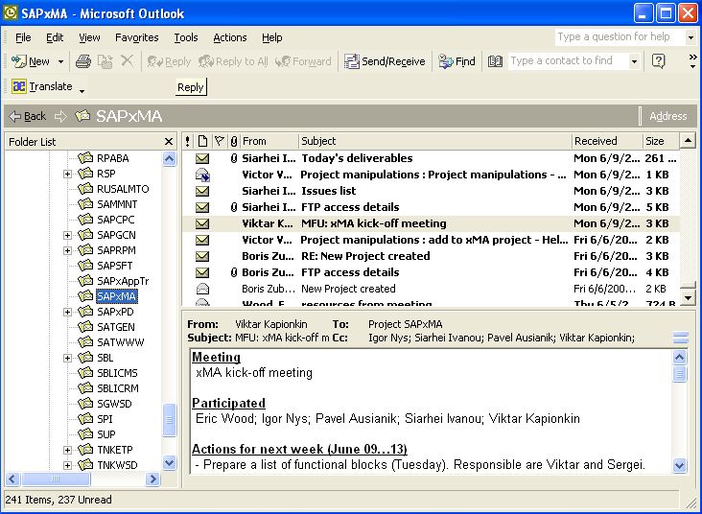
Initiation
Functional Testing Workflow: Initiation
Activities
Testers assignment
Kick-off meeting
Study and analyze of the SRS and other relevant project documentation
Artifacts
Project Resource request
Assignment letters
Report with results of analysis of SRS and other project documents
Notes:
Процесс начинается с момента получения ресурс менеджерами письменного запроса от менеджера проекта на выделение требуемых ресурсов для тестирования программного продукта.
После согласования указанных ресурсов, ресурс менеджер назначает специалистов, ответственных за тестирование этого проекта и посылает сообщение (письмо) менеджеру проекта.
Назначенные специалисты по функциональному тестированию принимают участие во вступительном собрании (в случае их назначения в начале проекта) и приступают к анализу проектной документации, на основании которого, ведущий специалист по тестированию (ВСТ) при необходимости разрабатывает рекомендации по корректировке документации для обеспечения возможности полноценного тестирования программного продукта и посылает их менеджеру проекта.

Slide 24
Main Stages
Functional Testing Workflow
Test
Designing
Test
Executing
Test
Planning
Analyze &
Reporting
Initiation
Completion

Slide 25
Test Planning
Functional Testing Workflow: Test Planning
Activities
Understand the operational (system, project, and process) and the organizational context of the testing to be performed
Define and prioritize the risks to system quality, and obtain stakeholders consensus on the extent of testing to mitigate these risks
Test Plan creation, confirmation and publishing
Test environment establishment
Artifacts
Test Plan
Test Hardware request
Notes:
Назначенный ведущий специалист по тестированию разрабатывает на основе анализа проектной документации тестовый план и согласовывает его с менеджером проекта и публикует утвержденный план в РМС. Начальная версия тестового плана должна быть направлена на утверждение руководителю группы до начала тестирования программного продукта.

Slide 26
Main Stages
Functional Testing Workflow
Test
Designing
Test
Executing
Test
Planning
Analyze &
Reporting
Initiation
Completion

Slide 27
Analysis and Design:
Test analysis and Test Design has the following major tasks: i. To review the test basis. (The test basis is the information we need in order to start the test analysis and create our own test cases. Basically it’s a documentation on which test cases are based, such as requirements, design specifications, product risk analysis, architecture and interfaces. We can use the test basis documents to understand what the system should do once built.) ii. To identify test conditions. iii. To design the tests. iv. To evaluate testability of the requirements and system. v. To design the test environment set-up and identify and required infrastructure and tools.

Slide 28
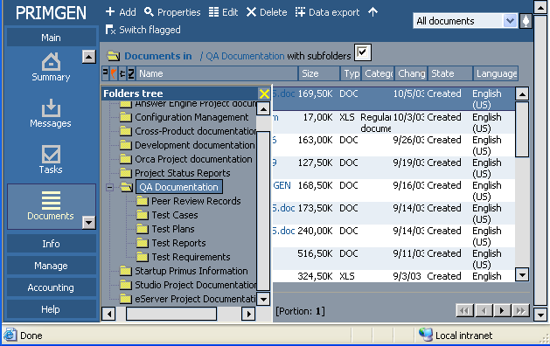
Test Designing
Activities
Test Procedures and Test Cases creation, confirmation and publishing
Automated Test Scripts
development (often after
the first build delivery)
Artifacts
Test Scenarios, Test Procedures and Test Cases
Automated Test Scripts
Notes:
Ведущий специалист по тестированию распределяет обязанности по тестированию программного продукта среди команды специалистов, выделенных для данного проекта, в соответствии с которыми, все участники тестирования разрабатывают тестовые сценарии для закрепленных за ними областей тестирования программного продукта. Ведущий специалист на их основе формирует тестовый сценарий для программного продукта в целом, согласует его с менеджером проекта и публикует в РМС. Тестовый сценарий должен быть утвержден до начала тестирования программного продукта. Тестовый сценарий может выполняться как вручную, так и с использованием средств автоматического тестирования. Часто приемочный тест выполняться автоматическим способом. В зависимости от реализации процесса в конкретном проекте тестовые сценарии могут содержать следующие типы тестов:
Приемочный тест (smoke test);
Критический тест (critical path test);
Расширенный тест (extended test).

Slide 29
Main Stages
Functional Testing Workflow
Test
Designing
Test
Executing
Test
Planning
Analyze &
Reporting
Initiation
Completion

Slide 30
Implementation and Execution:
During test implementation and execution, we take the test conditions into test cases and procedures and other testware such as scripts for automation, the test environment and any other test infrastructure.
Test implementation has the following major task: i. To develop and prioritize our test cases by using techniques and create test data for those tests. We also write some instructions for carrying out the tests which is known as test procedures.
Notes:
(Testware is a term for all utilities that serve in combination for testing a software like scripts, the test environment and any other test infrastructure for later reuse.)

Slide 31
Implementation and Execution:
We may also need to automate some tests using test harness and automated tests scripts. (A test harness is a collection of software and test data for testing a program unit by running it under different conditions and monitoring its behavior and outputs.) ii. To create test suites from the test cases for efficient test execution. iii. To implement and verify the environment.
Notes:
Test suite is a collection of test cases that are used to test a software program to show that it has some specified set of behaviours. A test suite often contains detailed instructions and information for each collection of test cases on the system configuration to be used during testing. Test suites are used to group similar test cases together.

Slide 32
Implementation and Execution:
Test execution has the following major task: i. To execute test suites and individual test cases following the test procedures. ii. To re-execute the tests that previously failed in order to confirm a fix. This is known as confirmation testing or re-testing. iii. To log the outcome of the test execution and record the identities and versions of the software under tests. The test log is used for the audit trial. (A test log is nothing but, what are the test cases that we executed, in what order we executed, who executed that test cases and what is the status of the test case (pass/fail). These descriptions are documented and called as test log.). iv. To Compare actual results with expected results. v. Where there are differences between actual and expected results, it report discrepancies as Incidents.

Slide 33
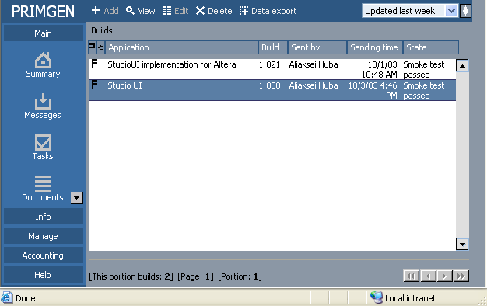
Test Executing
Activities
Build release notification
Checking required configuration and obligatory documents (What’sNew, ReadMe etc.)
Installation, Smoke Test execution and making decision pass/fail
Thorough testing – Critical Path and Extended Tests
Defects reporting
Artifacts
Notification – Installation passed/failed
Notification – Smoke Test passed/failed
Defect Reports
Automated test scripts
Updated Test Cases
Notes:
При получении сообщения РМС о выпуске новой версии программного продукта ВСТ проверяет соответствие конфигурации версии программного продукта проектной документации, команда тестирования приступает к инсталляции продукта на выделенном тестовом оборудовании, уточняет конфигурационную информацию (проверяет номер версии ПП, наличие требуемых компонент и т.п.) и проводит приемочный тест. Приемочный и другие типы тестов выполняются, если они предусмотрены тестовым планом. Как минимум один вид тестов должен быть предусмотрен в тестовом плане. Если приемочный тест не выполняется, то конечное состояние предназначенной для тестирования версии программного продукта в РМС должно быть Installed или Not installed.
В ходе приемочного и последующих типов тестов специалисты по тестированию проверяют соответствие исправленных дефектов, заявленных группой разработки программного продукта, их реальному состоянию и отображают их состояние в РМС. Кроме того, как и во время остальных видов тестирования, каждый обнаруженный в программном продукте дефект должен незамедлительно заноситься в РМС, откуда автоматически поступает уведомление о новом дефекте в группу разработки.
По результатам приемочного теста ведущий специалист по тестированию принимает решение о прохождении теста программным продуктом. Если тест не пройден, то он посылает через РМС сообщение о том, что версия программного продукта (ПП) не прошла приемочный тест (smoke test failed) и процесс тестирования данной версии заканчивается. При положительном решении посылается сообщение о прохождении теста (smoke test passed) и команда тестирования приступает к критическому и расширенному тестам, которые могут длиться продолжительное время (вплоть до нескольких рабочих дней). Как правило, данный процесс продолжается до момента выпуска новой версии программного продукта.

Slide 34
Main Stages
Functional Testing Workflow
Test
Designing
Test
Executing
Test
Planning
Analyze &
Reporting
Initiation
Completion

Slide 35
Evaluating Exit criteria and Reporting
Based on the risk assessment of the project we will set the criteria for each test level against which we will measure the “enough testing”. These criteria vary from project to project and are known as exit criteria. Exit criteria come into picture, when: — Maximum test cases are executed with certain pass percentage. — Bug rate falls below certain level. — When achieved the deadlines.
Evaluating exit criteria has the following major tasks: i. To check the test logs against the exit criteria specified in test planning. ii. To assess if more test are needed or if the exit criteria specified should be changed. iii. To write a test summary report for stakeholders.

Slide 36
Analyze and Reporting
Functional Testing Workflow: Analysis & Reporting
Activities
Defect metrics accounting and analysing
Communicating test results to key stakeholders. Weekly reporting.
Artifacts
Test Results Report
Notes:
ВСТ (СТ в случае закрепления за ним отдельного приложения из состава ПП) как правило в конце каждой рабочей недели создает отчет о результатах тестирования версии (нескольких версий) программного продукта и опубликовывает его в РМС. В случае, когда в течение рабочей недели версии ПП не выпускались, допускается не создавать данный отчет, при этом вся статистическая информация за данный период должна быть включена в следующий отчет за общий период. Шаблон отчета опубликован в РМС. Данные результаты обсуждаются на еженедельном общем собрании отдела функционального тестирования. Кроме того, при необходимости, ВСТ корректирует тестовые план и сценарий, согласует вносимые изменения в описанном ранее порядке и публикует обновленные версии документов в РМС.
Ведущий специалист по тестированию принимает участие в регулярных, как правило, еженедельных, хотя менеджер проекта может установить иную периодичность обсуждений, обсуждениях состояния проекта, а также в завершающем собрании по проекту.

Slide 37
Main Stages
Functional Testing Workflow
Test
Designing
Test
Executing
Test
Planning
Analyze &
Reporting
Initiation
Completion

Slide 38
Test Closure activities:
Test closure activities are done when software is delivered. The testing can be closed for the other reasons also like:
When all the information has been gathered which are needed for the testing.
When a project is cancelled.
When some target is achieved.
When a maintenance release or update is done.
Test closure activities have the following major tasks: i. To check which planned deliverables are actually delivered and to ensure that all incident reports have been resolved. ii. To finalize and archive testware such as scripts, test environments, etc. for later reuse. iii. To handover the testware to the maintenance organization. They will give support to the software. iv To evaluate how the testing went and learn lessons for future releases and projects.

Slide 39
Completion
Functional Testing Workflow: Completion
Activities
Final build acceptance and recommendation for production
Overall testing results summarization and evaluation
Participation in the Postmortem meeting
Artifacts
Test Evaluation Summary report
Post-Mortem Report, testing related sections
Notes:
Ну, и после того как продукт и оттестирован, и группа тестирования рекомендует его к поставке заказчику, процесс тестирования завершается. Это как раз то самое место, когда мы вырываемся из нашего замкнутого круга☺
***вопросы?***

Slide 40
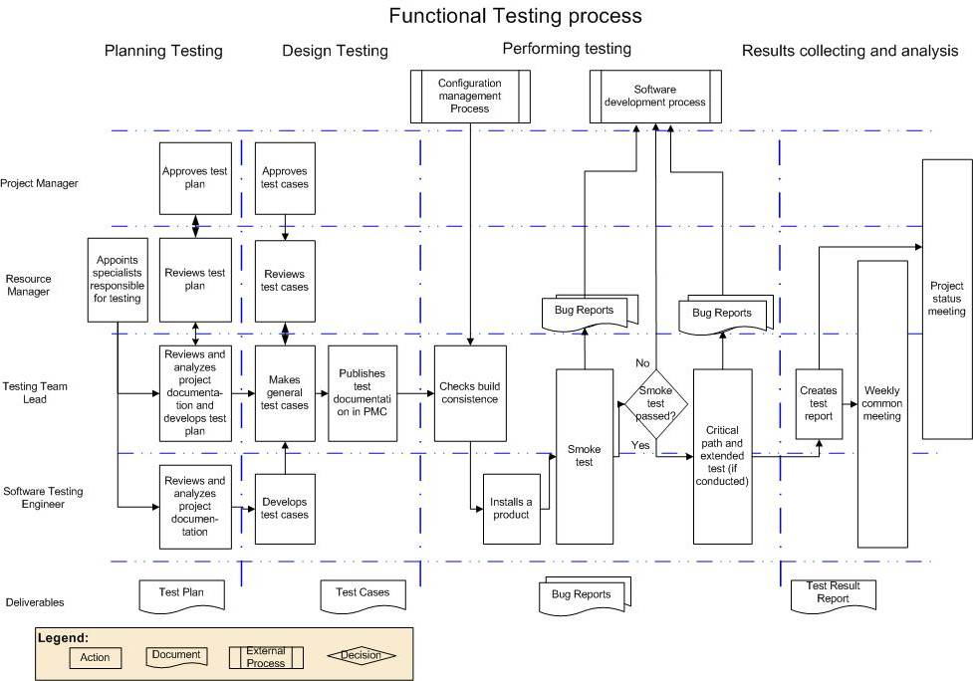
Notes:
Хорошо. Теперь предлагаю вам взглянуть на последний слайд сегодняшней темы. Это Схема процесса функционального тестирования, с которым мы только что познакомились. Здесь идут распределение по фазам тестирования и ролям в проекте.
***рассказать по слайду***

Slide 41
Testing Axioms
Why Testing Is Not So Trivial?

Slide 42
7 Testing Principles

Slide 43
7 Testing Principles
1) Testing shows presence of defects: Testing can show the defects are present, but cannot prove that there are no defects. Even after testing the application or product thoroughly we cannot say that the product is 100% defect free. Testing always reduces the number of undiscovered defects remaining in the software but even if no defects are found, it is not a proof of correctness.

Slide 44
Testing Can’t Show That Bugs Don’t Exist
Functional Testing: axioms
Testing can show that defects are present, but cannot prove that there are no defects.
Testing reduces the probability of undiscovered defects remaining in the software but, even if no defects are found, it is not a proof of correctness.
Notes:
Testing Can’t Show That Bugs Don’t Exist
Think about this for a moment. You’re an exterminator charged with examining a house for bugs. You inspect the house and find evidence of bugs—maybe live bugs, dead bugs, or nests.
You can safely say that the house has bugs.
You visit another house. This time you find no evidence of bugs. You look in all the obvious places and see no signs of an infestation. Maybe you find a few dead bugs or old nests but you see nothing that tells you that live bugs exist. Can you absolutely, positively state that the house is bug free? Nope. All you can conclude is that in your search you didn’t find any live bugs. Unless you completely dismantled the house down to the foundation, you can’t be sure that you didn’t simply just miss them.
Software testing works exactly as the exterminator does. It can show that bugs exist, but it can’t show that bugs don’t exist. You can perform your tests, find and report bugs, but at no point can you guarantee that there are no longer any bugs to find. You can only continue your testing and possibly find more.

Slide 45
7 Testing Principles
2) Exhaustive testing is impossible: Testing everything including all combinations of inputs and preconditions is not possible. So, instead of doing the exhaustive testing we can use risks and priorities to focus testing efforts.
For example: In an application in one screen there are 15 input fields, each having 5 possible values, then to test all the valid combinations you would need 30 517 578 125 (5¹⁵) tests. This is very unlikely that the project timescales would allow for this number of tests. So, accessing and managing risk is one of the most important activities and reason for testing in any project.

Slide 46
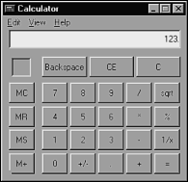
It’s Impossible to Test a Program Completely
Functional Testing: axioms
• The number of possible inputs is very large.
• The number of possible outputs is very large.
• The number of paths through the software is very large.
• The software specification is subjective. You might say that a bug is in the eye of the beholder.
Notes:
It’s Impossible to Test a Program Completely
As a new tester, you might believe that you can approach a piece of software, fully test it, find all the bugs, and assure that the software is perfect. Unfortunately, this isn’t possible, even with the simplest programs, due to four key reasons:
• The number of possible inputs is very large.
• The number of possible outputs is very large.
• The number of paths through the software is very large.
• The software specification is subjective. You might say that a bug is in the eye of the beholder.
Multiply all these “very large” possibilities together and you get a set of test conditions that’s too large to attempt. If you don’t believe it, consider the Microsoft Windows Calculator.
Assume that you are assigned to test the Windows Calculator. You decide to start with addition.
You try 1+0=. You get an answer of 1. That’s correct. Then you try 1+1=. You get 2. How far do you go? The calculator accepts a 32-digit number, so you must try all the possibilities up to
1+99999999999999999999999999999999=
Once you complete that series, you can move on to 2+0=, 2+1=, 2+2=, and so on. Eventually you’ll get to
99999999999999999999999999999999+99999999999999999999999999999999=
Next you should try all the decimal values: 1.0+0.1, 1.0+0.2, and so on.
Once you verify that regular numbers sum properly, you need to attempt illegal inputs to assure that they’re properly handled. Remember, you’re not limited to clicking the numbers onscreen—you can press keys on your computer keyboard, too. Good values to try might be
1+a, z+1, 1a1+2b2,…. There are literally billions upon billions of these.
Edited inputs must also be tested. The Windows Calculator allows the Backspace and Delete keys, so you should try them. 1<backspace>2+2 should equal 4. Everything you’ve tested so far must be retested by pressing the Backspace key for each entry, for each two entries, and so on.
If you or your heirs manage to complete all these cases, you can then move on to adding three numbers, then four numbers,….
There are so many possible entries that you could never complete them, even if you used a super computer to feed in the numbers. And that’s only for addition. You still have subtraction, multiplication, division, square root, percentage, and inverse to cover.
The point of this example is to demonstrate that it’s impossible to completely test a program, even software as simple as a calculator. If you decide to eliminate any of the test conditions because you feel they’re redundant or unnecessary, or just to save time, you’ve decided not to test the program completely.

Slide 47
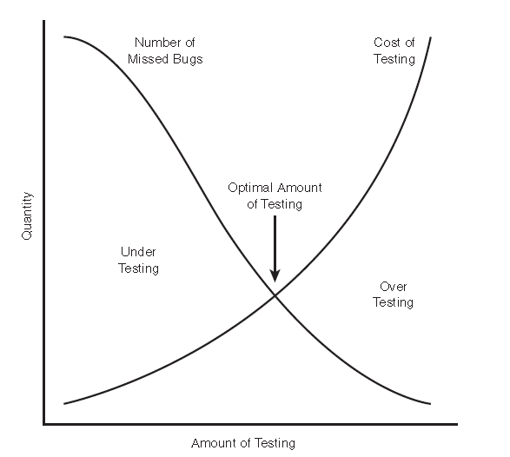
Software Testing Is a Risk-Based Exercise
Functional Testing: axioms
Notes:
If you decide not to test every possible test scenario, you’ve chosen to take on risk. In the calculator example, what if you choose not to test that 1024+1024=2048? It’s possible the programmer accidentally left in a bug for that situation. If you don’t test it, a customer will still
use it, and he or she will discover the bug. It’ll be a costly bug, too, since it wasn’t found until the software was in the customer’s hands.
This may all sound pretty scary. You can’t test everything, and if you don’t, you will likely miss bugs. The product has to be released, so you will need to stop testing, but if you stop too soon, there will still be areas untested. What do you do?
One key concept that software testers need to learn is how to reduce the huge domain of possible tests into a manageable set, and how to make wise risk-based decisions on what’s important to test and what’s not.
Figure shows the relationship between the amount of testing performed and the number of bugs found. If you attempt to test everything, the costs go up dramatically and the number of missed bugs declines to the point that it’s no longer cost effective to continue. If you cut the testing short or make poor decisions of what to test, the costs are low but you’ll miss a lot of bugs. The goal is to hit that optimal amount of testing so that you don’t test too much or too little.

Slide 48
7 Testing Principles
3) Early testing: In the software development life cycle testing activities should start as early as possible and should be focused on defined objectives.

Slide 49
Testers Aren’t the Most Popular Members of a Project Team
Find bugs early
Temper your enthusiasm
Don’t always report bad news
Notes:
Software Testers Aren’t the Most Popular Members of a
Project Team
Remember the goal of a software tester?
The goal of a software tester is to find bugs, find them as early as possible, and make sure they get fixed.
Your job is to inspect and critique your peer’s work, find problems with it, and publicize what you’ve found. Ouch! You won’t win a popularity contest doing this job.
Here are a couple of tips to keep the peace with your fellow teammates:
• Find bugs early. That’s your job, of course, but work hard at doing this. It’s much less of an impact and much more appreciated if you find a serious bug three months before, rather than one day before, a product’s scheduled release.
• Temper your enthusiasm. Okay, you really love your job. You get really excited when you find a terrible bug. But, if you bounce into a programmer’s cubicle with a huge grin on your face and tell her that you just found the nastiest bug of your career and it’s in her
code, she won’t be happy.
• Don’t always report bad news. If you find a piece of code surprisingly bug free, tell the world. Pop into a programmer’s cubicle occasionally just to chat. If all you ever do is report bad news, people will see you coming and will run and hide.

Slide 50
7 Testing Principles
4) Defect clustering: A small number of modules contains most of the defects discovered during pre-release testing or shows the most operational failures.

Slide 51
Defect Clustering
• Programmers have bad days.
• Programmers often make the same mistake.
• Some bugs are really just the tip of the iceberg.
Notes:
The More Bugs You Find, the More Bugs There Are
There are even more similarities between real bugs and software bugs. Both types tend to come in groups. If you see one, odds are there will be more nearby.
Frequently, a tester will go for long spells without finding a bug. He’ll then find one bug, then quickly another and another. There are several reasons for this:
• Programmers have bad days. Like all of us, programmers can have off days. Code written one day may be perfect; code written another may be sloppy. One bug can be a tell-tale sign that there are more nearby.
• Programmers often make the same mistake. Everyone has habits. A programmer who is prone to a certain error will often repeat it.
• Some bugs are really just the tip of the iceberg. Very often the software’s design or architecture has a fundamental problem. A tester will find several bugs that at first may seem unrelated but eventually are discovered to have one primary serious cause.
It’s important to note that the inverse of this “bugs follow bugs” idea is true, as well. If you fail to find bugs no matter how hard you try, it may very well be that the software was cleanly written and that there are indeed few if any bugs to be found.

Slide 52
7 Testing Principles
5) Pesticide paradox: If the same kinds of tests are repeated again and again, eventually the same set of test cases will no longer be able to find any new bugs. To overcome this “Pesticide Paradox”, it is really very important to review the test cases regularly and new and different tests need to be written to exercise different parts of the software or system to potentially find more defects.

Slide 53
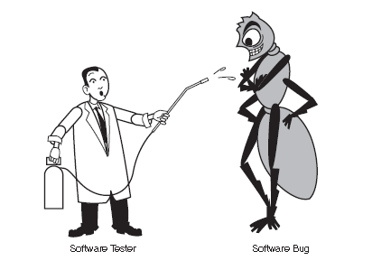
The Pesticide Paradox
Functional Testing: axioms
Notes:
In 1990, Boris Beizer, in his book Software Testing Techniques, Second Edition, coined the term pesticide paradox to describe the phenomenon that the more you test software, the more immune it becomes to your tests. The same thing happens to insects with pesticides. If you keep applying the same pesticide, the insects eventually build up resistance and the pesticide no longer works.
Remember the spiral model of software development ? The test process repeats each time around the loop. With each iteration, the software testers receive the software for testing and run their tests. Eventually, after several passes, all the bugs that those tests would find are exposed. Continuing to run them won’t reveal anything new.
To overcome the pesticide paradox, software testers must continually write new and different tests to exercise different parts of the program and find more bugs.

Slide 54
7 Testing Principles
6) Testing is context depending: Testing is basically context dependent. Different kinds of sites are tested differently. For example, safety – critical software is tested differently from an e-commerce site.

Slide 55
7 Testing Principles
7) Absence – of – errors fallacy: If the system built is unusable and does not fulfil the user’s needs and expectations then finding and fixing defects does not help.

Slide 56
Testing Axioms
additional

Slide 57
Not All the Bugs You Find Will Be Fixed
Functional Testing: axioms
There’s not enough time
It’s really not a bug
It’s too risky to fix
It’s just not worth it
Notes:
There are several reasons why you might choose not to fix a bug:
• There’s not enough time. In every project there are always too many software features, too few people to code and test them, and not enough room left in the schedule to finish. If you’re working on a tax preparation program, April 15 isn’t going to move—you must have your software ready in time.
• It’s really not a bug. Maybe you’ve heard the phrase, “It’s not a bug, it’s a feature!” It’s not uncommon for misunderstandings, test errors, or spec changes to result in would-be bugs being dismissed as features.
• It’s too risky to fix. Unfortunately, this is all too often true. Software is fragile, intertwined, and sometimes like spaghetti. You might make a bug fix that causes other bugs to appear. Under the pressure to release a product under a tight schedule, it might be too risky to change the software. It may be better to leave in the known bug to avoid the risk of creating new, unknown ones.
• It’s just not worth it. This may sound harsh, but it’s reality. Bugs that would occur infrequently or bugs that appear in little-used features may be dismissed. Bugs that have work-arounds, ways that a user can prevent or avoid the bug, are often not fixed. It all comes down to a business decision based on risk.

Slide 58
When a Bug’s a Bug Is Difficult to Say
Functional Testing: axioms
1. The software doesn’t do something that the product specification says it should do.
2. The software does something that the product specification says it shouldn’t do.
3. The software does something that the product specification doesn’t mention.
4. The software doesn’t do something that the product specification doesn’t mention but should.
5. The software is difficult to understand, hard to use, slow, or—in the software tester’s eyes — will be viewed by the end user as just plain not right.
Notes:
If there’s a problem in the software but no one ever discovers it—not programmers, not testers, and not even a single customer—is it a bug?
Get a group of software testers in a room and ask them this question. You’ll be in for a lively discussion. Everyone has their own opinion and can be pretty vocal about it. The problem is that there’s no definitive answer. The answer is based on what you and your development team decide works best for you.
Let us consider the rules to define a bug:
1. The software doesn’t do something that the product specification says it should do.
2. The software does something that the product specification says it shouldn’t do.
3. The software does something that the product specification doesn’t mention.
4. The software doesn’t do something that the product specification doesn’t mention but should.
5. The software is difficult to understand, hard to use, slow, or—in the software tester’s eyes—will be viewed by the end user as just plain not right.
Following these rules helps clarify the dilemma by making a bug a bug only if it’s observed.
To claim that the software does or doesn’t do “something” implies that the software was run and that “something” or the lack of “something” was witnessed. Since you can’t report on what you didn’t see, you can’t claim that a bug exists if you didn’t see it.
Here’s another way to think of it. It’s not uncommon for two people to have completely different opinions on the quality of a software product. One may say that the program is incredibly buggy and the other may say that it’s perfect. How can both be right? The answer is that one has used the product in a way that reveals lots of bugs. The other hasn’t.

Slide 59
Product Specifications Are Never Final
The specification will change:
Features will be added that you didn't plan to test.
Features will be changed or even deleted that you had already tested and reported bugs on.
A product specification is an agreement among the software development team. It defines the product they are creating, detailing what it will be, how it will act, what it will do, and what it won't do.
Notes:
Product Specifications Are Never Final
Software developers have a problem. The industry is moving so fast that last year’s cutting-edge products are obsolete this year. At the same time, software is getting larger and gaining more features and complexity, resulting in longer and longer development schedules. These two opposing forces result in conflict, and the result is a constantly changing product specification.
There’s no other way to respond to the rapid changes. Assume that your product had a locked down, final, absolutely-can’t-change-it product spec. You’re halfway through the planned two year development cycle, and your main competitor releases a product very similar to yours but with several desirable features that your product doesn’t have. Do you continue with your spec as is and release an inferior product in another year? Or, does your team regroup, rethink the product’s features, rewrite the product spec, and work on a revised product? In most cases, wise business dictates the latter.
As a software tester, you must assume that the spec will change. Features will be added that you didn’t plan to test. Features will be changed or even deleted that you had already tested and reported bugs on. It will happen. You’ll learn techniques for being flexible in your test planning and test execution.

Slide 60
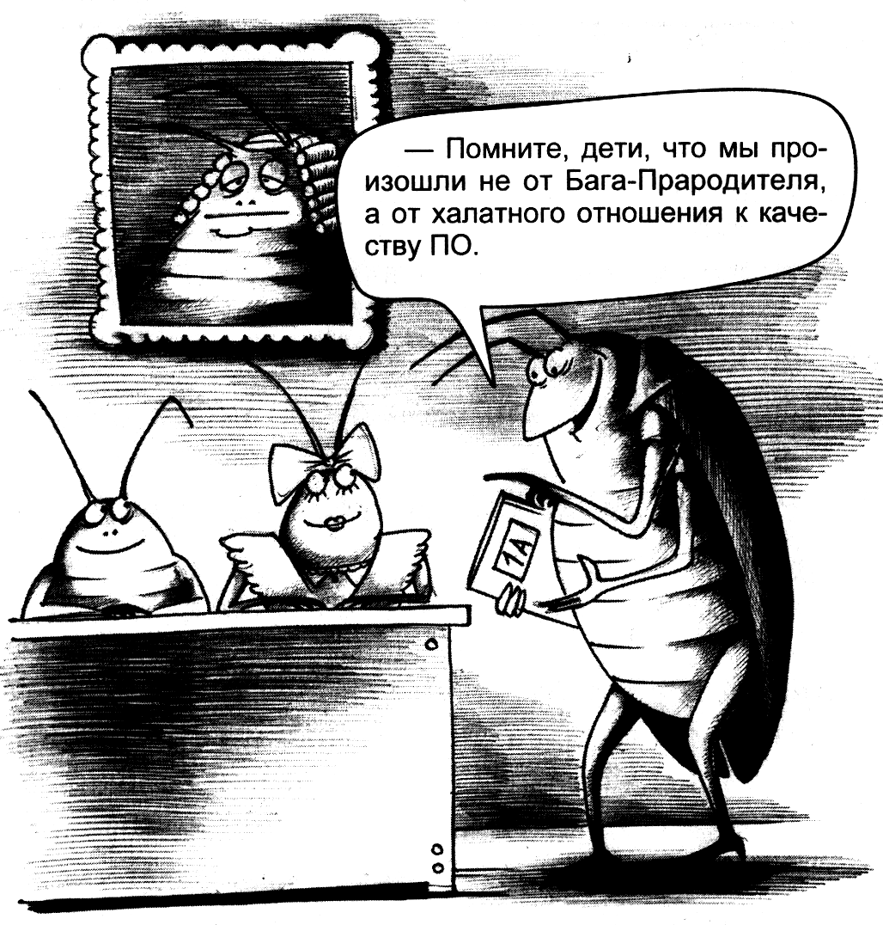
Remember! ;)

Slide 61
Your Global Technology Outsourcing Partner
Thanks for your attention
EPAM Systems, Inc.
http://www.epam.com
NTUU “KPI”
http://kpi.ua
EPAM POWER POINT TITLE
Sub Topic
® 2011. EPAM Systems. All rights reserved.

